Slide 2
读后续写的高分体现
达意领先
（把故事讲清楚，发生了什么，故事的（过程）转折点是什么，结果是什么；解决了什么问题；什么lesson）
逻辑合理
（基于主题下的续写，捕捉上文有效信息，根据提供的段落，设计情节（情感发展，解决问题）
漂流瓶：love，a new friend，happiness， 前文内容的协同性

Slide 3


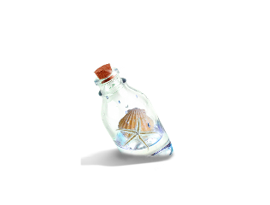






I stared at the paper and then looked around. I was cold. Although I could not see my sisters nor the new house, which was hidden from my sight by a grey wall, I got the feeling that I was not alone. Walking along the shore was a tall familiar figure who looked lost in his thoughts. I looked again at the paper in my hand, closed my eyes and wished.
As I opened my eyes, I found my father was standing right beside me. “Happy Birthday, son,” he said, patting my shoulder gently. I smiled up at him and took his hand. Looking back, life from that day on marked the start of a close bond and a strong friendship with my father. What was my birthday surprise? Wishes do come true.

Slide 4
I stared at the paper and then looked around. I was cold. Although I could not see my sisters nor the new house, which was hidden from my sight by a grey wall, I got the feeling that I was not alone(why?). Walking along the shore was a tall familiar figure who looked lost in his thoughts. I looked again at the paper in my hand, closed my eyes and wished. 61
As I opened my eyes, I found my father was standing right beside me. “Happy Birthday, son,” he said, patting my shoulder gently....? I smiled up at him and took his hand....? Looking back, life from that day on marked the start of a close bond and a strong friendship with my father. What was my birthday surprise? Wishes do come true. new friend? 48

Slide 5
I stared at the paper and then looked around. On the backside, there was a map. I noticed that it was clearly leading me in a direction, but who could have sent this? I stood there in silence and studied it. I decided to follow the map and it led me down the beach until I reached a staircase. I looked back and could no longer see my siblings. I continued to follow the point on the map, until I unexpectedly lost my footing and fell down the steps.
As I opened my eyes, I found my father was standing right beside me.“Happy Birthday, son,” he said, patting my shoulder gently. Then he asked how I had come upon this place? I explained to him that I had found the bottle in the ocean and when I opened it had the words on it. Shocked by the message, my father realized what I had found. “I threw this bottle into the ocean many years ago when I was alone.” he said. “I used to come to this exact place to get away from everyone else. Now I get to share this experience with you.” What a birthday surprise!
解决了生日问题和漂流瓶；a new friend? 前文的协同度?
what a new surprise !主题显得单薄

Slide 6
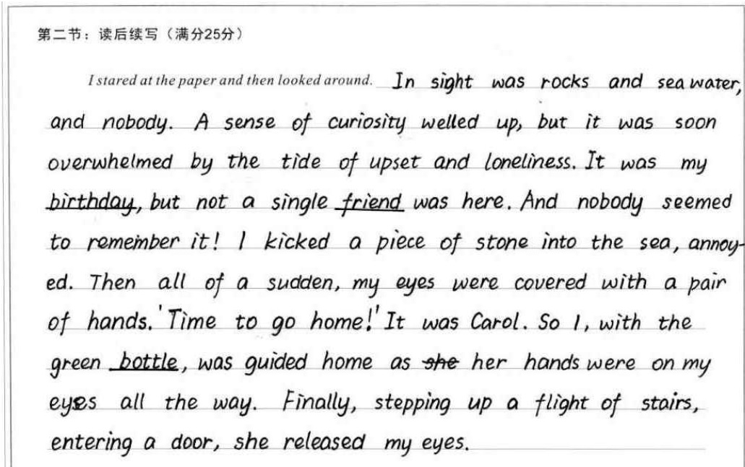
Example of reasonable development:
点评：
本段的续写与首句衔接融洽，从所见（空旷无人），到所感（寂寞失落），到Carol出现（蒙眼领我回家），情节设置合理，为下一段中问题的解决和主题的总结作了恰当的铺垫；语言上心理活动、动作描写到位，语言的积累和运用还是不错的。

Slide 7
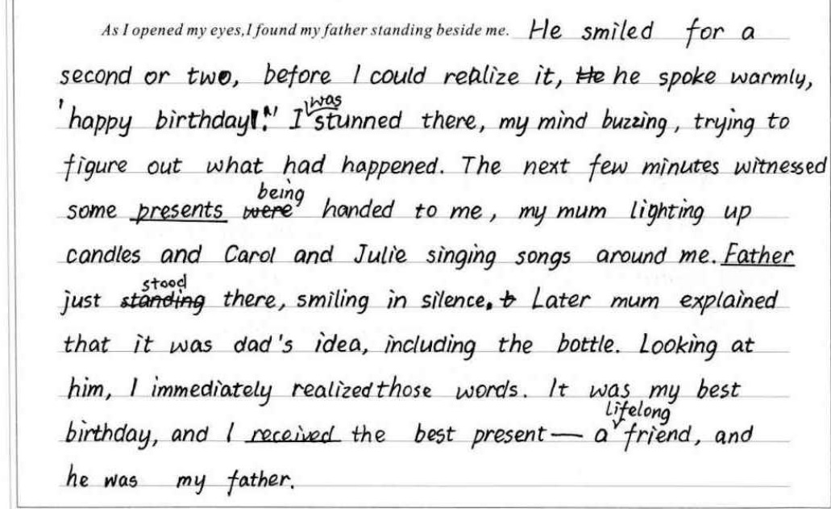
Example of reasonable development:
点评：
本段在情节上解决了birthday和friend的问题，紧扣主题，语言上对无灵主语、非谓语的使用值得赞赏。另外，作者在结尾呼应上文，交待了bottle的由来，把father- friend- present都串了起来,虽略显生硬，主题升华也略显单薄，语前文的协同度一般，但在考场上能对所有因素都有所兼顾，已实属不易。

Slide 8
I stared at the paper and then looked around. In the near distance came the joyful laughter of Carol and Julie, seemingly having found some extraordinary shells out of their expectation, and at my foot, the waves of tide kept touching the rock periodically. Not a single magic or any sign shew. I lowered down my head and glued my eyes to the rest of the paper. “All you need to do is close your eyes for ten minutes,” read the paper. So I did, with a strong curiosity to guess who this promised friend would be. Slowly, I felt the gentle breeze on my face, combing through my hair, which helped clear my thought. Far from the busty and noisy city, I realized that it was a quiet and lovely place that my father brought us to actually.

Slide 9
As I opened my eyes, I found my father standing right beside me. How did he come to my side unnoticeably? I searched for an answer on his still gloomy face, while holding the paper tightly. Father broke the silence first. “Sorry, ” he relieved a sigh. “ I know it is your birthday, but I can’ t afford you any presents. You know…” I briskly cut his words by replying “Don’t say that, Daddy. You have provided us with everything, always. Just now I found a new friend at this beach.” Startled by my answer, father asked in astonishment “So soon? Who is this friend?” I chuckled at his abrupt reaction “I found at my heart rests a quiet soul who prefers the vast and deep ocean to be a friend.” on3: I found an unusual friend

Slide 10
读后续写的高分体现
达意领先
（把故事讲清楚，发生了什么，故事的（过程）转折点是什么，结果是什么；解决了什么问题；什么lesson）
逻辑合理
（基于主题下的续写，捕捉上文有效信息，根据提供的段落，设计情节（情感发展，解决问题）
情感真实
情感变化清晰合理；表达不要太夸张，符合人物性格和心理
语言生动
（tell 和show相结合;对话不宜过多）

Slide 11
读后续写的高分体现
使用动词链
Having selected for long, he picked out some most delicate cards, mixed them with the former pile and replaced them carefully.

Slide 12
读后续写的高分体现
主位推进和语义焦点增强写作逻辑感
That evening, the family sat happily, enjoying the delicious meal and most importantly, the time together. Though the time may be short, it could last in everyone’s memory, forever.
I manage to pull my head out of the pumpkin, but in vain.
My legs were just like jelly, rooted to the ground.

Slide 13
读后续写的高分体现
适度使用悬垂结构
Annoyed by his strange behaviour and silent attitude, I stepped forward, intending to stop him to get my answer.

Slide 14
读后续写的高分体现
适度使用修辞手法
His face was lightly flushed, like a passionate artist, drawing peculiar images on one card after another.

Slide 15
读后续写的高分体现
找准时机收尾(收的快，不宜太长太多），
结尾要精心设计
When we saw a big smile on Michael Roger’s face when he opened the box, all the efforts paid off.
原文的结尾
But I caught myself smiling at the nice thing he did. Maybe he is not so bad ater all. Maybe he’s evev kind of sweet...in a hidden sort of way.
I dumped the rest of my Valentine’s Day cookies into Michael Rogers’s box. I’d planned to make more cookies after school, anyway. Maybe I’ll even give some to Michael Peterson.

Slide 16
Reminder:
长句频繁，使人疲惫
The moment I was about to help, it suddenly hit me that what if he was just pretending and acting to fool me with his ridiculous and mean tricks. Concluded from his naughty and annoying nature, it wasn’t an exception for him to give me a shock and tease me for believing his plays and performances...
长短句结合为佳

Slide 17
Reminder:
中式英语
When the cards in his hand appeared into my sight...
The whole thing became clear enough...

Slide 18
Reminder:
盲目追求高大上
Half-exasperated (annoyed) and half amazed
leaving my face mimicking a ripe apple

Slide 19
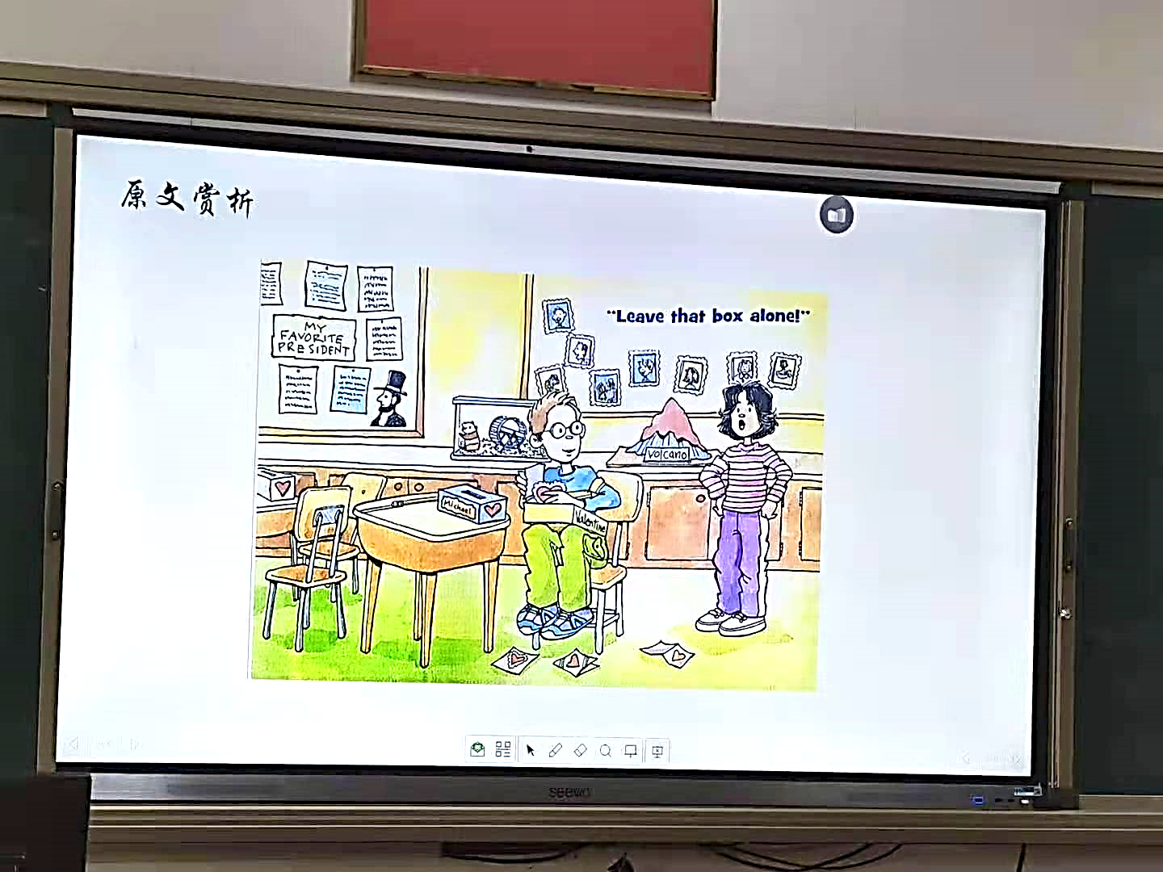

A Valentine’s trick

Slide 20

从续写前文中找主题和续写点:
Break was almost over. Normally. I didn’t bother to keep track of Michael Peterson. I tried to ignore him. But today was Valentine's Day, a special day for children to exchange "valentine cards” with each of their classmates. No way was I going to let him play a mean trick today.
Michael Peterson sits next to me in class. He’s also my neighbor. So I know him. And I was sure he was up to something, because he always is. Last week, he put a sign on my back that said Sing to Me! It was terrible. Sure, maybe it was funny at first, if a little confusing. Everywhere I went, people I didn’t even know started singing to me. But once I realized it was just because of the sign on my back, I was extremely angry. Michael played tricks like that all the time. So I knew what he was doing now-- ruining someone's Valentine's Day.
I was going to stop him. But where was he? He wasn’t on the playground for break as supposed to be. “Have you seen Michael?” I asked Josh, who swung down from the monkey bars and said,“Which Michael?”
“ Michael Peterson，” I said. I had forgotten about Michael Rogers, the new kid in our class
Josh shrugged. “Haven’t seen him.” Then he grinned. “He's probably off playing a funny trick.”
I sighed. “That’s what I'm afraid of.” I headed for the classroom. There was Michael Peterson--
at Michael Rogers’ desk, digging in his box of valentine cards!“ Michael, leave that box alone!” I ordered.
“Hurry and help me, ” Michael said.
I stared at him in amazement. He wanted me to help him? “No way! ”I said, thinking that hewas stealing valentine cards from Michael Rogers' box. Then, after watching him for a moment, I added, “What are you doing anyway?”
Para 1. The more I watched my next-door neighbor, the more confused I became.
Para 2. I stood there, not quite believing what I was hearing.

Slide 21
续写前文中找主题和续写点:
I was going to stop him. But where was he? He wasn’t on the playground for break as supposed to be. “Have you seen Michael?” I asked Josh, who swung down from the monkey bars and said,“Which Michael?”
“ Michael Peterson，” I said. I had forgotten about Michael Rogers, the new kid in our class
Josh shrugged. “Haven’t seen him.” Then he grinned. “He's probably off playing a funny trick.”
I sighed. “That’s what I'm afraid of.” I headed for the classroom. There was Michael Peterson--at Michael Rogers’ desk, digging in his box of valentine cards!“ Michael, leave that box alone!” I ordered.
“Hurry and help me, ” Michael said.
I stared at him in amazement. He wanted me to help him? “No way! ”I said, thinking that he was stealing valentine cards from Michael Rogers' box. Then, after watching him for a moment, I added, “What are you doing anyway?”
Q：What was Michael Peterson doing there?
Did I believe Michael Peterson’s explanation?
Would I help him at first?
结合前文信息： As a new comer in the class, Michael Rogers might have been forgotten by the other kids to exchange love cards with him. Would Michael Peterson play tricks or send cards?

Slide 22


theme
to blame Michael Peterson for his being naughty?
to praise Michael Peterson for his hidden kindness?
to narrate an impressive trick on Valentine’s Day?
to think highly of myself for my justice?
Peterson and Rogers played a trick on me together, which was unexpected.
From then on, Peterson was not brave enough to steal cards from others.

Slide 23
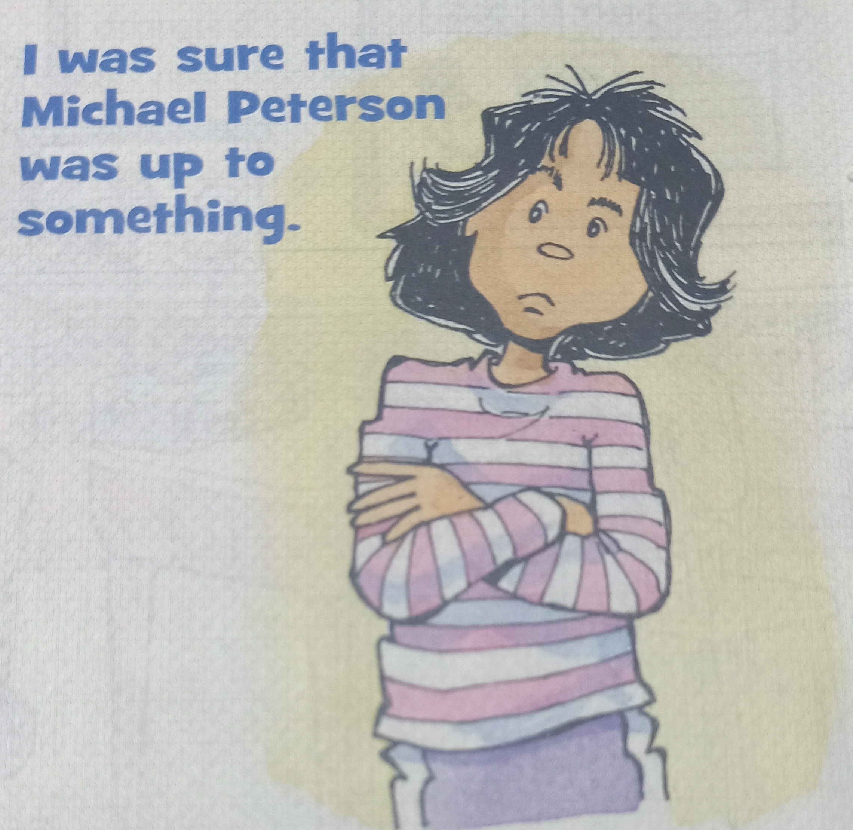
Plotting
is always up to something
Problem-solving
ruining someone’s
Valentine’s Day
is not so bad at all
情节反转
How？
helping someone on the special day

Slide 24

从所给段首句找续写点并设计有效情节（3 scenes)
动作描写
心理描写
适当的有效对话
Para 1. The more I watched my next-door neighbor,
the more confused I became.
What did I watch?
Why did “I” become more confused?
What would he explain?
“I” refused to help him first.
He explained something to me.
Para 2. I stood there, not quite believing what I was hearing.
How did “I” feel after I heard his explanation?
What did “we” do together?
Lesson gained

Slide 25
他忙于在卡片盒里翻找，汗水从脸上滴下来。
2. “快来帮我”，他催促道。
3. 我眨了眨眼，但不回答。
4. 我皱了皱眉,冷冷地指责他不该捉弄新同学。
5. 他拼命向我解释。
Sweat trickled down his face as he dug in the card boxes.
Come and help me, "he urged.
I blinked but gave no reply.
I frowned and scolded him coldly for playing tricks on the new student.
He tried hard to explain to me desperately.

Slide 26
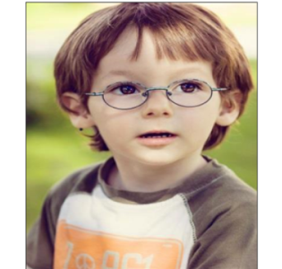
从所给段首句找续写点并设计有效情节:
sure, worried
careful/
eager
Para 1. The more I watched my next-door neighbor,
the more confused I became.
hurried, anxious
What did I watch?
Why did “I” become more confused?
What would he explain?
对应：He didn’t play tricks but……
对应：He seemed to do something good.
annoyed,
worried
对应：He wanted to send love cards.
Para 2. I stood there, not quite believing what I was hearing.
amazed
confused;
How did “I” feel after I heard his explanation?
What did “we” do together and how did I feel?
hopeful/delighted
Embarrassed
对应：I was moved and helped him make cards together.
embarrassed
satisfied/hopeful
I cleared the misunderstanding--- Michael Peterson was not a bad but a nice boy.

Slide 27

Para 2. I stood there, not quite believing what I was hearing.
听了他真诚的解释，我尴尬地甚至歉意地笑了笑。
我的脸上掠过一阵尴尬的红晕。
我感到很尴尬，低下头.羞愧使我顿时哑口无言。
我感到一种既尴尬又满足的混合心情涌上心头。
我搔着头，歉意地喃喃自语。
我羞得满脸通红，想偷偷溜出去而不被人发现。
Hearing his sincere explanation I smiled in an awkward, almost apologetic, way.
A flush of embarrassment swept across my face.
Embarrassed
awkward
satisfied
Embarrassed, I dropped my head. Shame suddenly silenced me
I felt a mixture of embarrassment and satisfaction striking into my heart.
I scratched my head，mumbling apologetically.
I flushed with shame and tried to sneak out without being seen.

Slide 28
手里拿着制作精美的卡片，他兴奋地尖叫起来。
读着卡片上的字，他笑了。
我们交换了满意的眼神，沉浸在幸福之中。
我们躲在门后，激动得浑身发抖。
With the well-drawn cards in hand, he screamed with excitement.
Reading the words on the cards, he grinned.
When he read the best wishes on the cards, excitememnt
was dancing in his eyes.
We exchanged satisfied eyes, immersed in happiness.
We hid behind the door, trembling with excitement.

Slide 29
本次续写主要问题
缺乏主题意识（（Peterson wasn’t as bad a boy as I thought of;)主题没有得到很好地传达
没有按照主题有效设计情节；情节发展逻辑性不够严密，或与原文情节融洽度不高；与段首句的协同不够（what I heard)；
文化差异
不了解Valentine’s Day 的真正含义;没有注意到中外名字的表达差异given/first name + family name（Michael Peterson; Michael Rogers) ；没有了解国外break 期间教室一般没人；

Slide 30

Valentine's Day
Valentine's Day is a special day of love!
It is a day to celebrate friendship and love.
It is a time to give little gifts to special people
It is a day to make handmade valentine cards for your family and friends.
It is a time to share a story and a smile with
someone you like.

Slide 31

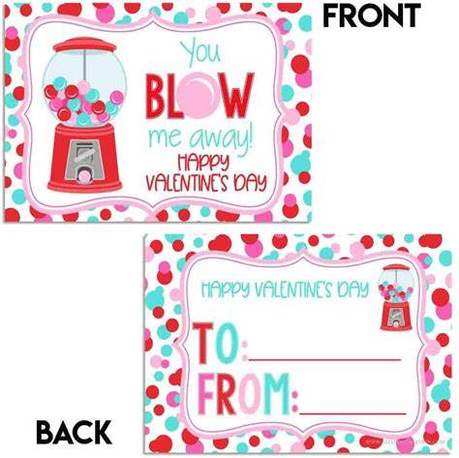
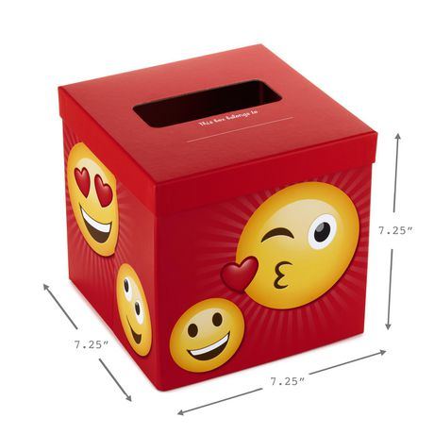
输入您的文字内容
输入您的文字内容
Effects on others
Thoughts
输入您的文字内容
Michael
Josh

Slide 32
Para.1
The more I watched my next-door neighbor, the more confused I became. I had no idea about what Michael Peterson was doing but thinking of the trick he once played on me. Suddenly, a wave of anger flooded into my whole body. I felt my blood boiling. I strode towards Michael Roger’s desk, firmly determined to stop his evil behaviors. But what I saw next thoroughly surprised me. He was putting some cards carefully into Roger’s box. “As a new kid, he might have been forgotten by our classmates. I just sent him some cards I received. After all, all they were sent to Michael.” he tried to explained , ‘‘Now I’m going to make some new cards for him. Would you like to join me?’’
Para.2
I stood there, not quite believing what I was hearing. With my jaw drooping, I almost popped my eyes out of my head. Rooted in the ground, I felt my face flush. How silly was I for having thought Peterson was stealing valentine cards from Roger’s box! To make up for my mistake, I decided to help Peter make new cards. Peterson was delighted for my participation. For the following moment, we cooperated with each other with great enjoyment. I drew vivid pictures to decorate the cards while my next-door neighbor added some best wishes on them. At the very last second before the bell rang for the next class, we two grabbed hold of all the cards we made, placing them into Roger’s box with satisfaction. What a relief! A big surprise was there, waiting for our new classmate, Michael Roger. Not until then did I recognize a brand-new Michael Peterson!
照应前文Peterson人物形象
延续前文angry情绪
照应前文stop his trick情节
照应my feeling 转折及说明关键词watch内容
照应前文a new kid & had forgotten & two Michael情节并将解释将“恶作剧”真相浮出水面。承上启下
照应并再次铺垫前文help情节
延续情绪线embarrassed/ashamed
照应并完成help情节构建
照应主题love/kindness 反转人物形象

Slide 33
The more I watched my next-door neighbor, the more confused I became.Instead of taking valentines out of the box, he was putting them in. But whatever he did, I was sure it was wrong. I scolded him for picking on the poor kid. Michael just kept working and denied playing a trick. He explained that he was the last person to pass out his valentines before break. When he got to Michael Rogers’ box, he noticed it was empty. No one remembered to make the new kid a card. So actually he was giving him his cards. After all, the cards he received from classmates all said “Michael “ on them.
I stood there, not quite believing what I was hearing. “ You mean you’re doing something nice?” I asked. “Of course. When haven’t I been nice?” he teased. I blinked but gave no reply. I helped Michael to shake out his cards through the slot in his valentine box.Then we stuffed the cards into Michael Rogers’ box. I felt a mixture of embarrassment ad satisfaction striking into my heart. Maybe I had misunderstood him and maybe he’s even kind of sweet... in a hidden sort of way.

Slide 34
languange

Slide 35
Learn topic vocabulary：school life
翻译：
别费心去做了
跟踪
试图忽略某人
开……的玩笑
坐在我旁边
策划/谋划
在操场上休息
从单杠上荡下来
Don’t bother to do
Keep track of
try to ignore sb.
play a trick on
sit next to me
be up to something
on the playground for break
swing down from the monkey bars
课间休息结束了，同学们从操场上一个接一个有说有笑地回来。
Break was now over and my classmates came back from the playground one after another, talking and laughing.

Slide 36
Learn topic vocabulary：characterization
No way was l going to…
I was sure.
I was going to stop him.
He always is.
Played tricks like that all the time.
That’s what I’m afraid of.
“Leave that box alone!”
"No way!”
What kind of person was“I”？_______________________
What would “I” say when “I” saw Michael Peterson sitting at Michael Rogers’ desk?
_________________________________________________
upright a bit reckless(鲁莽）
“You are doing something nice? You must be kidding!”

Slide 37
Pay attention to the linguistic style
simple, precise,
vivid. varied, pictorial
vivid verbs and adj.,adv. &prep. phrase
荡下去
耸肩
咧开嘴笑
叹气
前往
命令
凝视，盯住
补充说
swing down
shrug
糟糕的
滑稽的
令人困惑的
极度愤怒地
惊讶地
terrible
grin
funny
sigh
confusing
head for
extremely angry
order
in amazement
stare at
add
如：我耸了耸肩，盯着他，不相信地问：“你送爱心卡给他？”
I shrugged, stared at him, and asked in disbelief, "You are making him a love card?”

Slide 38
Learn from the varied sentence structures
正常情况我不会费心跟迈克尔·彼得森联系。（adv.）
2. 我今天决不会让他耍卑鄙的花招。（倒装句）
3.上周，他在我背上放了个牌子，上面写着:“给我唱歌吧!”(定从)
4.无论我走到哪里，我甚至不认识的人都开始对我唱歌。
Normally， I didn’t bother to keep track of Michael Peterson.
No way was I going to let him play a mean trick today.
Last week, he put a sign on my back that said Sing to Me!
Everywhere I went, people I didn’t even know started singing to me.

Slide 39
Learn from the varied sentence structures
5. 迈克尔·彼得森在那儿——在迈克尔·罗杰斯的办公桌前，在他那盒情人节卡片里挖呀挖呀!”（用非谓语）
6. 我越观察隔壁的邻居，就越感到困惑。
7. 我站在那里，不太相信我所听到的。
There was Michael Peterson--at Michael Rogers' desk, digging in his box of valentine cards!
The more I watched my next-door neighbor, the more confused I became.
I stood there, not quite believing what I was hearing

Slide 40

How to write
Para 1. The more I watched my next-door neighbor,
the more confused I became.
How to describe Peterson’s behavior?
How did he explain?
How to describe my feeling?
was buried in/focused on…digging in the box
Sweat dripped from one's face;
Sweat trickled down his forehead...
murmured; urged; pointed ; turned over
explained to me desperately; apologized;
drew; made; exchanged
Michael
Peterson
Para.1
amazed
confused;
frowned， blinked, my expression hardened
stared at him angrily in disbelief
warned him; tried to drive him away
rooted there with my eyes widened
“I”

Slide 41
Try to use the words and phrases
他忙于在卡片盒里翻找，汗水从脸上滴下来。
2. “快来帮我”，他催促道。
3. 我眨了眨眼，但不回答。
4. 我皱了皱眉,冷冷地指责他不该捉弄新同学。
5. 他拼命向我解释。
6. 我从来没想到他会做好事。
7. 发现果然是上面写着”Michael”的爱心卡片，我瞪大眼睛呆立在哪里。
Sweat trickled down his face as he dug in the card boxes.
Come and help me, "he urged.
I blinked but gave no reply.
I frowned and scolded him coldly for playing tricks on the new student.
He tried hard to explain to me desperately.
Never did it occur to me that he could do anything good.
Having realized it was a love card that said "Michael" on it, I froze/ rooted there with my eyes widened.

Slide 42
He explained about his behavior
He explained that he was trying to put valentine cards into Rogers' box.
Magically, he took out a few cards from his pocket and stuffed/pressed/squeezed them into the box.
“Yes, it is truly a trick, but I’ve played it out of kindness,” he teased.
This morning he noticed that nobody remembered to prepare cards for Rogers. So he intended to give Rogers his cards. After all, the cards said to Michael on them.
Coincidentally, Rogers’ given name was Michael. So he would consider that the cards in his box were specially ready for him.

Slide 43
Para 2. I stood there, not quite believing what I was hearing.
听了他真诚的解释，我尴尬地甚至歉意地笑了笑。
我的脸上掠过一阵尴尬的红晕。
我感到很尴尬，低下头.羞愧使我顿时哑口无言。
我感到一种既尴尬又满足的混合心情涌上心头。
我搔着头，歉意地喃喃自语。
我羞得满脸通红，想偷偷溜出去而不被人发现。
Hearing his sincere explanation I smiled in an awkward, almost apologetic, way.
A flush of embarrassment swept across my face.
Embarrassed
awkward
satisfied
Embarrassed, I dropped my head. Shame suddenly silenced me
I felt a mixture of embarrassment and satisfaction striking into my heart.
I scratched my head，mumbling apologetically.
I flushed with shame and tried to sneak out without being seen.

Slide 44
Embarrassment enveloped me totally.
A flush of relief swept over me.
What I was trying to stop turned out to be an act of kindness.
It was Michael Peterson who remembered to bring happiness to Michael Rogers, a new comer who had been ignored on this special day.
After making a sincere apology to him, I helped him carry out the great task.
I was moved by Peterson's hidden kindness.
I could imagine that no sooner had Rogers opened his box than a brilliant smile spread across his face.
Surely, he would fit into the lovely class smoothly.
That was the most meaningful Vatlentine's Day I had ever experienced.

Slide 45
I helped Michael to shake out his cards through the slot(狭槽） in his valentine box.
Then we stuffed the cards into Michael Rogers’ box.
Confusion had faded away. Instead happiness occupied the corner of the classroom.

Slide 46
手里拿着制作精美的卡片，他兴奋地尖叫起来。
读着卡片上的字，他笑了。
我们交换了满意的眼神，沉浸在幸福之中。
我们躲在门后，激动得浑身发抖。
With the well-drawn cards in hand, he screamed with excitement.
Reading the words on the cards, he grinned.
When he read the best wishes on the cards, excitememnt
was dancing in his eyes.
We exchanged satisfied eyes, immersed in happiness.
We hid behind the door, trembling with excitement.

Slide 47

About the language and writing style
尽可能用精彩的名词、
动词、形容词和副词等实词；
巧用小词，如介词；
虚词越少越好
How to improve your language
How to make your writing style consistent with the original
一是把握理解语言风格
在读后续写中传达原文风格
在续写中，关键看语言，语言的准确和得体最重要！

Slide 48
Para.1
The more I watched my next-door neighbor, the more confused I became. I had no idea about what Michael Peterson was doing but thinking of the trick he once played on me. Suddenly, a wave of anger flooded into my whole body. I felt my blood boiling. I strode towards Michael Roger’s desk, firmly determined to stop his evil behaviors. But what I saw next thoroughly surprised me. He was putting some cards carefully into Roger’s box. “As a new kid, he might have been forgotten by our classmates. I just sent him some cards I received. After all, all they were sent to Michael.” he tried to explained , ‘‘Now I’m going to make some new cards for him. Would you like to join me?’’
Para.2
I stood there, not quite believing what I was hearing. With my jaw drooping, I almost popped my eyes out of my head. Rooted in the ground, I felt my face flush. How silly was I for having thought Peterson was stealing valentine cards from Roger’s box! To make up for my mistake, I decided to help Peter make new cards. Peterson was delighted for my participation. For the following moment, we cooperated with each other with great enjoyment. I drew vivid pictures to decorate the cards while my next-door neighbor added some best wishes on them. At the very last second before the bell rang for the next class, we two grabbed hold of all the cards we made, placing them into Roger’s box with satisfaction. What a relief! A big surprise was there, waiting for our new classmate, Michael Roger. Not until then did I recognize a brand-new Michael Peterson!
照应前文Peterson人物形象
延续前文angry情绪
照应前文stop his trick情节
照应my feeling 转折及说明关键词watch内容
照应前文a new kid & had forgotten & two Michael情节并将解释将“恶作剧”真相浮出水面。承上启下
照应并再次铺垫前文help情节
延续情绪线embarrassed/ashamed
照应并完成help情节构建
照应主题love/kindness 反转人物形象

Slide 49
The more I watched my next-door neighbor, the more confused I became.Instead of taking valentines out of the box, he was putting them in. But whatever he did, I was sure it was wrong. I scolded him for picking on the poor kid. Michael just kept working and denied playing a trick. He explained that he was the last person to pass out his valentines before break. When he got to Michael Rogers’ box, he noticed it was empty. No one remembered to make the new kid a card. So actually he was giving him his cards. After all, the cards he received from classmates all said “Michael “ on them.
I stood there, not quite believing what I was hearing. “ You mean you’re doing something nice?” I asked. “Of course. When haven’t I been nice?” he teased. I blinked but gave no reply. I helped Michael to shake out his cards through the slot in his valentine box.Then we stuffed the cards into Michael Rogers’ box. I felt a mixture of embarrassment ad satisfaction striking into my heart. Maybe I had misunderstood him and maybe he’s even kind of sweet... in a hidden sort of way.

